Slide 1
Pneumonia Classification Using Chest X-Ray with Probabilistic Neural Network

Slide 2
Problem summary
Pneumonia is a lung parenchyma inflammation often caused by pathogenic microorganisms, factors of physical and chemical, immunologic injury and other pharmaceuticals.
Pneumonia kills more than 800,000 children under five per year, with around 2200 deaths every day.
There are more than 1400 children infected with pneumonia per 100,000 children.
With technology developing, more and more measures are developed, in which radiology-based methods are most popular and useful.
Diagnostic radiological techniques for pulmonary disease include chest X-ray imaging, computed tomography (CT), and magnetic resonance imaging (MRI), among which chest X-ray imaging is most effective and economical as it is more available and portable in hospital and has lower exposures of dose radioactivity for patients.
Hence, in this project, we propose a Convolutional Neural Network to diagnose pneumonia through X-ray images automatically and obtain results of high accuracy score.

Slide 3
Dataset Summary
The dataset is organized into 3 folders (train, test, val) and contains subfolders for each image category (Pneumonia/Normal).
There are 5,863 X-Ray images (JPEG) and 2 categories (Pneumonia/Normal).
Chest X-ray images (anterior-posterior) were selected from retrospective cohorts of pediatric patients of one to five years old from Guangzhou Women and Children’s Medical Center, Guangzhou.
All chest X-ray imaging was performed as part of patients’ routine clinical care.
For the analysis of chest x-ray images, all chest radiographs were initially screened for quality control by removing all low quality or unreadable scans.
The diagnoses for the images were then graded by two expert physicians before being cleared for training the AI system.
In order to account for any grading errors, the evaluation set was also checked by a third expert.
https://www.kaggle.com/paultimothymooney/chest-xray-pneumonia

Slide 4
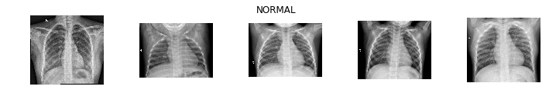
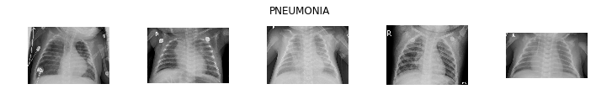
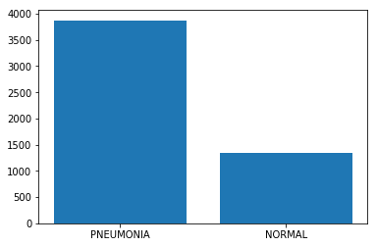
Dataset Summary

Slide 5
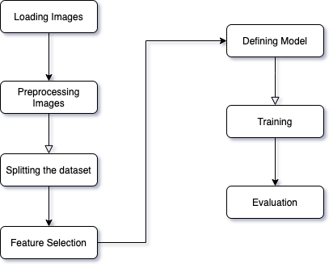
Work summary
Preprocessing methods are
Resize
Normalization
Rotation Range
Zoom Range
Weight_Shift_Range
Height_Shift_Range
Horizontal_Flip True
Vertical_Flip
Datasets will be splitted into train, test, validation.
Probabilistic Neural Network is used as classifier for this project
True Positive, True Negative, False Positive, False Negative, are used to analyze and identify the performance of model with the help of confusion matrix.

Slide 6
Work summary
A probabilistic neural network (PNN) is a sort of feedforward neural network used to handle classification and pattern recognition problems.
In the PNN technique, the parent probability distribution function (PDF) of each class is approximated using a Parzen window and a non-parametric function.
The PDF of each class is then used to estimate the class probability of fresh input data, and Bayes’ rule is used to allocate the class with the highest posterior probability to new input data.
With this method, the possibility of misclassification is lowered.
This type of ANN was created using a Bayesian network and a statistical approach known as Kernel Fisher discriminant analysis.

Slide 7
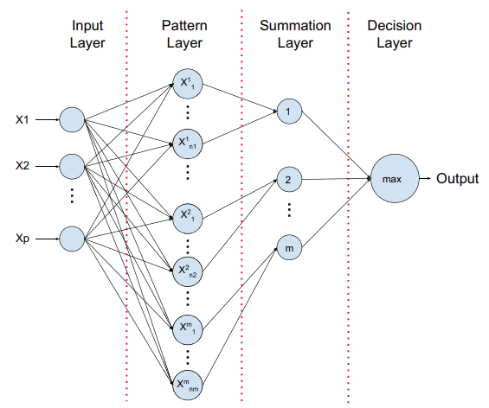
Work summary
Input Layer
Each predictor variable is represented by a neuron in the input layer. When there are N categories in a categorical variable, N-1 neurons are used. By subtracting the median and dividing by the interquartile range, the range of data is standardized. The values are then fed to each of the neurons in the hidden layer by the input neurons.
Pattern Layer
Each case in the training data set has one neuron in this layer. It saves the values of the case’s predictor variables as well as the target value. A hidden neuron calculates the Euclidean distance between the test case and the neuron’s center point, then uses the sigma values to apply the radial basis kernel function.
Summation Layer
Each category of the target variable has one pattern neuron in PNN. Each hidden neuron stores the actual target category of each training event; the weighted value output by a hidden neuron is only supplied to the pattern neuron that corresponds to the hidden neuron’s category. The values for the class that the pattern neurons represent are added together.
Decision Layer
The output layer compares the weighted votes accumulated in the pattern layer for each target category and utilizes the largest vote to predict the target category.

Slide 8
Validation method
A confusion matrix is a table that is often used to describe the performance of a classification model (or "classifier") on a set of test data for which the true values are known.
The confusion matrix itself is relatively simple to understand, but the related terminology can be confusing.
true positives (TP): These are cases in which we predicted yes (they have the disease), and they do have the disease.
true negatives (TN): We predicted no, and they don't have the disease.
false positives (FP): We predicted yes, but they don't actually have the disease. (Also known as a "Type I error.")
false negatives (FN): We predicted no, but they actually do have the disease. (Also known as a "Type II error.")

Slide 9
Results summary
The datasets are divided into two: 70% used in training and 30% used for testing.
The performances of the models are evaluated based on testing accuracy, sensitivity, and specificity from the confusion matrix.
Carried out a multiclass classification, we trained each type of pneumonia with healthy (non-pneumonia or non infected) CXR images.
Achieved 60% testing accuracy, 61% sensitivity, and 61% specificity.

Slide 10
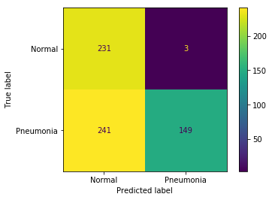

Results summary

Slide 11
Conclusion
This work presents the use of Probabilistic neural network based on the bayesian theorem for automatic detection of pneumonia, non pneumonia chest X-Ray.
The models were trained based on two binary classes.
The models were evaluated based on accuracy, sensitivity, and specificity.
However, the result has shown that for classification of for non viral pneumonia and healthy datasets, the model achieved 60% testing accuracy, 61% sensitivity, and 61% specificity.
One of the limitations of this research is the fact that we used a small dataset of pneumonia.
We can increase the performance using pretrained model.

